Slide 1
Final Presentation
William Sun

Slide 2
Summary
Team members: William Sun
How did you solve the problem: Linear Regression
Final results:
Rank: 12
Score: 21.92163
What have you learned:
Implementing and experimenting with multiple ML and DL models
Experience with PyTorch, sklearn

Slide 3
Key Words
MLP
Motion Prediction Forecasting
Linear Regression
Velocity

Slide 4
Introduction

Slide 5

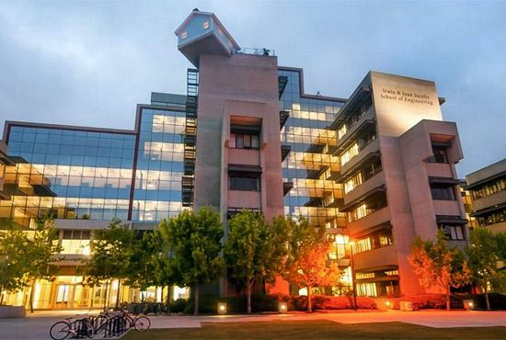
Team Introduction
William Sun:
Senior, Computer Engineering
Background: CSE 151A, CSE 152A

Slide 6
Methodology

Slide 7
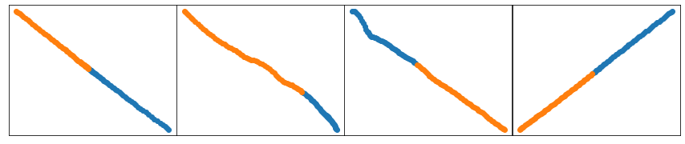
Data Processing
Summary: the prediction task will consist of taking in 50 positional coordinates which are ordered in time (5 seconds), and output the next 60 predicted positional coordinates in time (6 seconds)
Initially: 80/20 training/validation split was used
No normalization was used → performance was satisfactory
Idea: implement min-max normalization
Visualize sample data batch (Austin #3000)

Slide 8
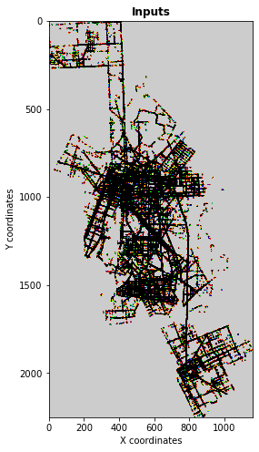

Data Visualization
Use imshow() to visualize positions
Findings:
many straight lines
densely packed regions

Slide 9
Deep Learning Model
DL models tested:
MLP
Encoder/Decoder
LSTM
Transformer
Loss function: sum of squares
Initial hypothesis: more powerful methods would be better (LSTM and transformer)
Findings: simpler feed forward neural network worked better
most data has linear trends, and simple patterns in the data are more geared towards the simpler models
complex models not sufficiently tuned during experimentation

Slide 10
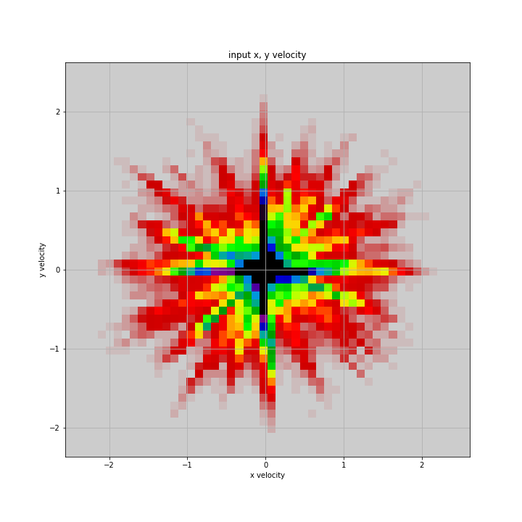
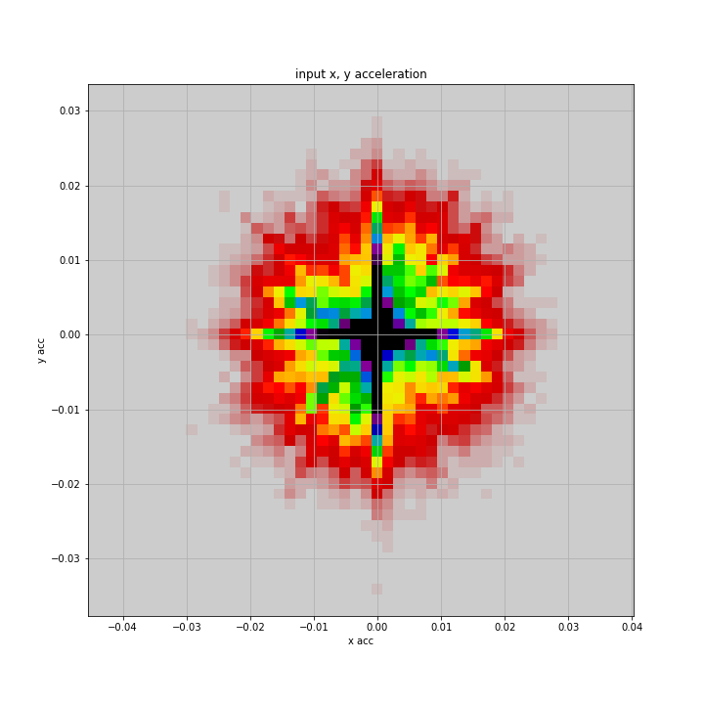
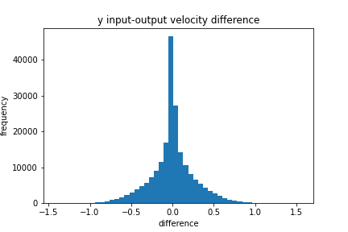
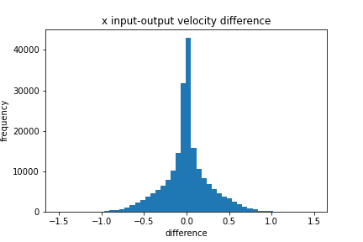
Engineering Tricks
Idea: take advantage of physics of real-life model → agents must move based on a model of motion
Use velocity information
Use acceleration information
Visualize trends of velocity and acceleration in input and output data
Visualize relationship between input and output data
Findings:
most data points to linear movement (near-zero acceleration
input and output data has little difference (constant change)

Slide 11
Experiments

Slide 12
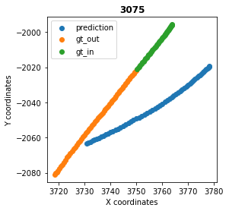
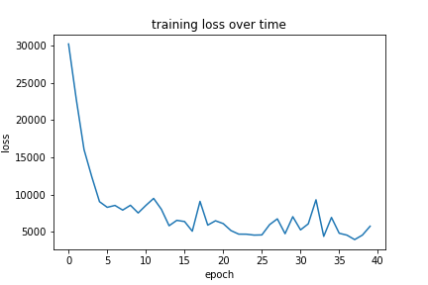
Experiment 1
Encoder/Decoder Model: inspired by discussion 7 architecture
Parameters:
Encoder - 4 hidden layers, Decoder - 4 hidden layers, Batch-size - 4, lr - 1e-3
Findings: relatively inaccurate (test loss ~1000)

Slide 13
Experiment 2
Median vs Mean
Use same velocity model with acceleration for both tests, just compare median and mean selection
Model description: calculate the median/mean velocity and acceleration for the 50 input data points, and use this value to interpolate the next 60 future output data points
Findings:
Median performs better (~70 vs ~50 loss)
Suggests outliers greatly affect mean model

Slide 14
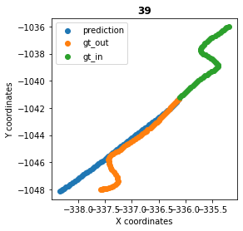
Experiment 3
Linear Regression:
use 60 separate models total in the linear regression implementation, where each model is prediction the 51-110th timestamps respectively
Findings: very accurate (test loss ~20)
simple is better
see image to right, performs weakly against data that has non-linear trends
luckily, data visualization shows that most data is linear

Slide 15
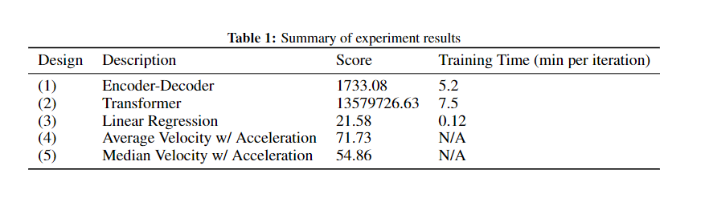
Summary of Results

Slide 16
Discussion

Slide 17
What have you learned
Handling outliers is extremely effective and important for an accurate model based on this data, as shown by the median/mean tests
Data visualization was most helpful in the early stages of the project
Most agents moved in a straight line indicated that a linear model and a simple model would work well
The biggest bottleneck in this project was setting up the training environment and training itself
Begin experimentation with the simplest possible models first
In this case, simplest performed best!
Use advice from the reference papers
They already provide insights into successful models

Slide 18
Future Work
With more computation resources and training time:
try to tune more complex models to be successful
LSTM and transformer models
Continue tuning hyperparameters for linear regression
Implement ensemble forest methods for regression
Apply nearest neighbor approach to test data based on training data
May not be effective in real-time, but effective in a competition setting
Implement more pre/post processing techniques
min/max normalization for input data
Kalman filter
Interpolate data to generate more features or collect more data to develop more complex models

